Slide 1
AI-Powered Home Trade System
Xiaobai Liu
Dhaval Sharma

Slide 2
Transaction Assistance Platform
Buyer’s guide for making an offer
Seller’s guide for countering an offer
Buyer’s guide for countering an offer
Seller’s guide for making a deal
Buyer’s guide for house inspection and request to require

Slide 3
Week 1
Understanding the problem
Learning about Django
Preparing skeleton framework
Configuring skeleton framework
Creating the Buyer’s Offer application
Creating the database and models
Creating the admin view
Creating the URLs and the UI

Slide 4
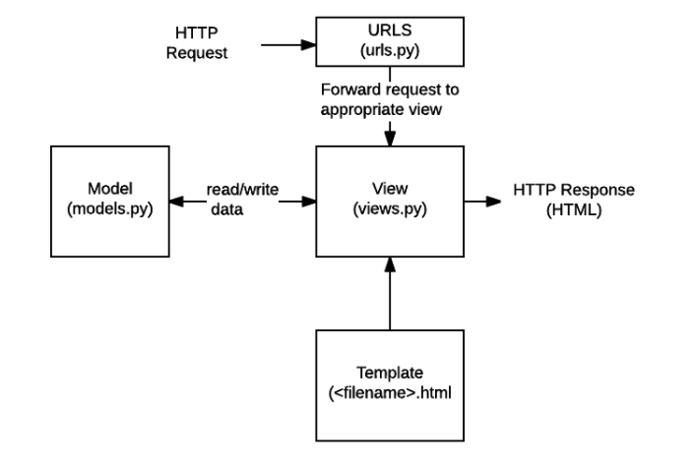
Overall Process

Slide 5
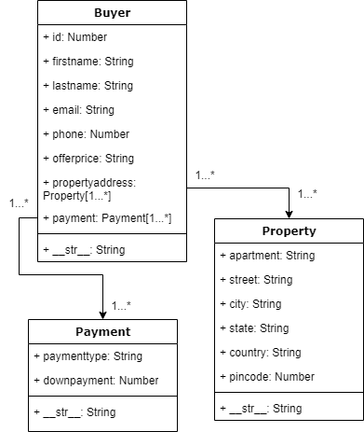
Database Schema

Slide 6
Week 2
Understanding the PDFs
Exploring the possible options
Limitations with the first and second methods
Third method
Creating Helper function
Issues
Testing the PDF writing code
Updating the database, admin and UI

Slide 7
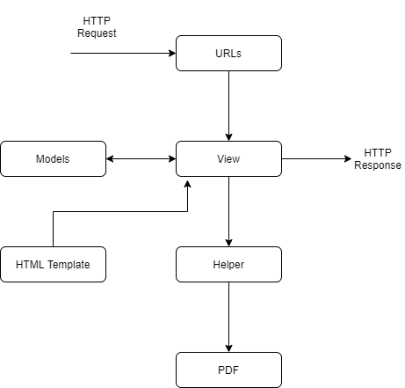
Structure

Slide 8
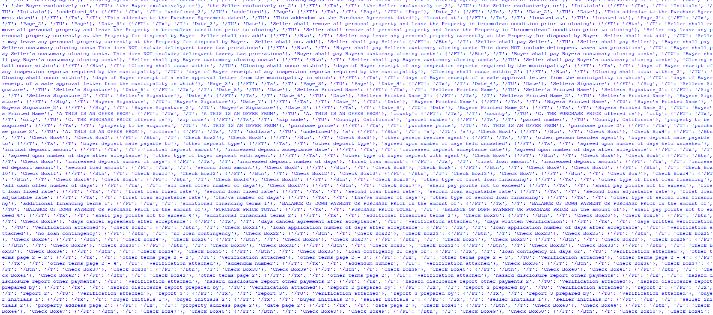
PDF Writing Objects

Slide 9
Demo

Slide 10
Thank You!

